Slide 1

AJAX-2
SHARMA COMPUTER ACADEMY

Slide 2
What is JSON ?
JSON stands for Java Script Object Notation .
It is a data interchange format .
Used for representing and transmitting data from the server
to the client or vice-versa.

Slide 3
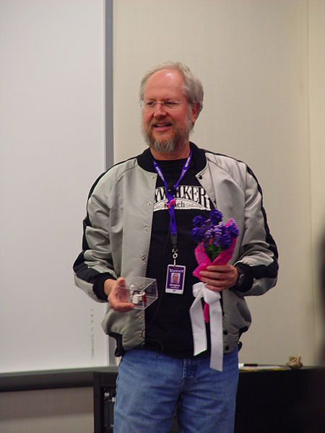
Json history
The man behind JSON
Developed by Douglas Crockford in 2002.
Later on sold to SUN-MICROSYSTEMS.
In 2005 adopted by Yahoo , followed by Google in 2006.

Slide 4
Why use json ?
Can be easily be sent to and from a server.
Every popular programming language supports JSON
For example :
Java provides a method called toJson() to convert a Java object to JSON.
Python has a method called dumps() to convert a Python object to JSON.
JS has a method called stringify() to convert a JS object to JSON.

Slide 5
Converting json to js
JavaScript has a built in method to convert a string, written in JSON format, into native JavaScript objects:
So, if we receive data from any server, in JSON format, we can use
it like any other JavaScript object.
JSON.parse(jsonStr)

Slide 6
Json syntax
The JSON syntax is a subset of the JavaScript syntax.
JSON Syntax rules
JSON syntax is derived from JavaScript object notation syntax.
Data is in name/value pairs.
Data is separated by commas.
Curly braces hold objects.
Square brackets hold arrays.

Slide 7
Json data
JSON data is written as name/value pairs.
A name/value pair consists of a field name (in double quotes), followed by a colon, followed by a value:
Note:- In JSON, keys must be strings, written with double quotes.
{ "name":"Ravi"}

Slide 8
Json sample
{
"book": [
{
"id": "B-101",
"language": "Java",
"edition": "third",
"author": "Herbert Schildt"
},
{
"id": "B-102",
"language": "C++",
"edition": "second",
"author": "E.Balagurusamy“
}
]
}

Slide 9
Data types supported by json
In JSON, all values must be one of the following data types:
String
Number
Object
Array
Boolean
null

Slide 10
Json strings
JSON Strings: Strings in JSON must be written in double quotes.
Example:
{ "name":"Ravi"}

Slide 11
Json numbers
JSON Numbers: Numbers in JSON must be int or a floating point
Example:
{"age":30}

Slide 12
Json objects
JSON Objects: Values in JSON can be objects also
Example:
{
"employee":{ "name":"Ravi", "age":30, "city":"Delhi" }
}

Slide 13
Json arrays
JSON Arrays: Values in JSON can be arrays also
Example:
{
"employees":[ "Ravi", "Amit", "Piyush" ]
}

Slide 14
Json null value
JSON Null Value: Values in JSON can be null also
Example:
{ "commission":null }

Slide 15
Converting json data to javascript object
When we receive JSON data from a web server, the data is always a string.
To handle this data easily and efficiently we need to convert it into JavaScript object and this is done with JSON.parse(),

Slide 16
Converting json data to javascript object
Example:-
Imagine we received this text from a web server:
Now we can use JSON.parse() to convert this whole string data
to JS object.
'{ "name":"Ravi", "age":30, "city":"Delhi"}'

Slide 17
Exercise -2
<!DOCTYPE html>
<html>
<body>
<h2>Create Object from JSON String</h2>
<p id="demo"></p>
<script>
let txt = '{"name":"John", "age":30, "city":"New York"}';
let obj = JSON.parse(txt);
document.getElementById("demo").innerHTML = obj.name + "," + obj.age;
</script>
</body>
</html>

Slide 18
Exercise-3
Assume we have a JSON file present on the server
called person_details.json.
Write an AJAX based application to get this file
from the server and display it on the page.

Slide 19
The json file present on server
person_details.json
{
"name":"Ravi",
"age":30,
"projects":[
{
"language":"Java SE",
"name":"Tech Quizz App"
},
{
"language":"Java EE",
"name":"Online Voting App"
},
{
"language":"JavaScript",
"name":"Weather App"
}
]
}

Slide 20
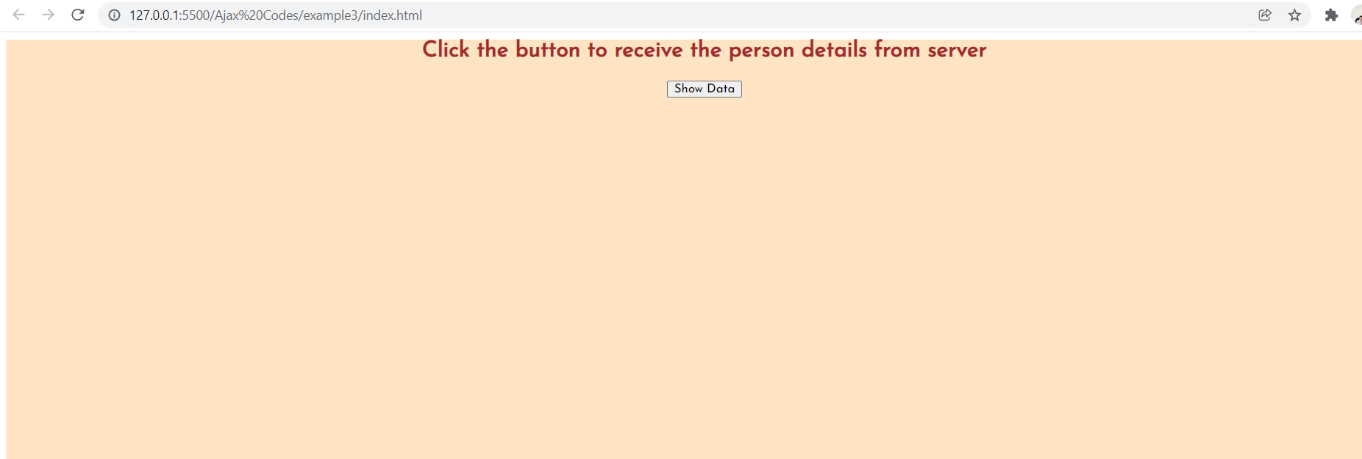
Desired output

Slide 21
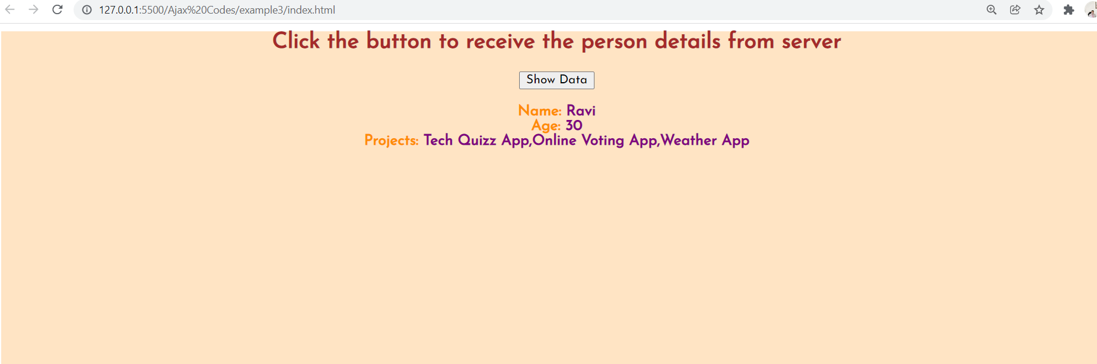
Desired output

Slide 22
solution
index.html
<html>
<head>
<title>AJAX Example 3</title>
<script src="app.js"></script>
<link rel="stylesheet" href="styles.css"></link>
</head>
<body>
<div id="container">
<h2>Click the button to receive the person details from server</h2>
<input type="button" value="Show Data" onclick="connect()" /><br /><br/>
<span id="person"></span>
</div>
</body>
</html>

Slide 23
solution
styles.css
@import url("https://fonts.googleapis.com/css2?family=Josefin+Sans:wght@100;400&display=swap");
* {
font-family: "Josefin Sans", sans-serif;
}
div {
background-color: bisque;
color: brown;
text-align: center;
height: 100%;
}
span {
color: purple;
font-weight: bold;
}

Slide 24
solution
app.js
let xhr;
function connect() {
xhr = new XMLHttpRequest();
xhr.onreadystatechange = processresponse;
xhr.open("GET", "person_details.json", true);
xhr.send(null);
}

Slide 25
solution
app.js
function processresponse() {
if (xhr.readyState === 4 && xhr.status === 200) {
let personSpan = document.getElementById("person");
let jsonResponse = xhr.responseText;
const obj = JSON.parse(jsonResponse);
personSpan.innerHTML =
"<span>Name: </span> " +
obj.name +
"<br><span>Age: </span> " +
obj.age +
"<br>";
let str = "";
for (let p of obj.projects) {
str += p.name + ",";
}
str = str.substring(0, str.lastIndexOf(","));
personSpan.innerHTML += "<span>Projects: </span>" + str;
} else if (xhr.readyState === 4 && xhr.status !== 200) {
alert("Sorry! The request cannot be processed\nReason:" + xhr.statusText);
}
}

Slide 26

Thanks!
Any questions?
You can find me at:
Email id: info@scalive.in
Contact no. : +917314853128

